Slide 1

X-Reporto
Slogan…………………………….

Slide 2

TABLE OF CONTENTS
01
02
01
03
04
05
05
06
06
Problem
Motivation
Market
Our Tool
DISCUSSION
CONCLUSION

Slide 3

01
Problem

Slide 4
Problem Definition
Radiologists in the U.S. perform on average over 70 million chest X-rays each year.
Cost for imaging and professional reading/interpretation is very high
In developing regions, These areas often don’t have the resources to fully support their healthcare systems or to properly train new radiologists.

Slide 5
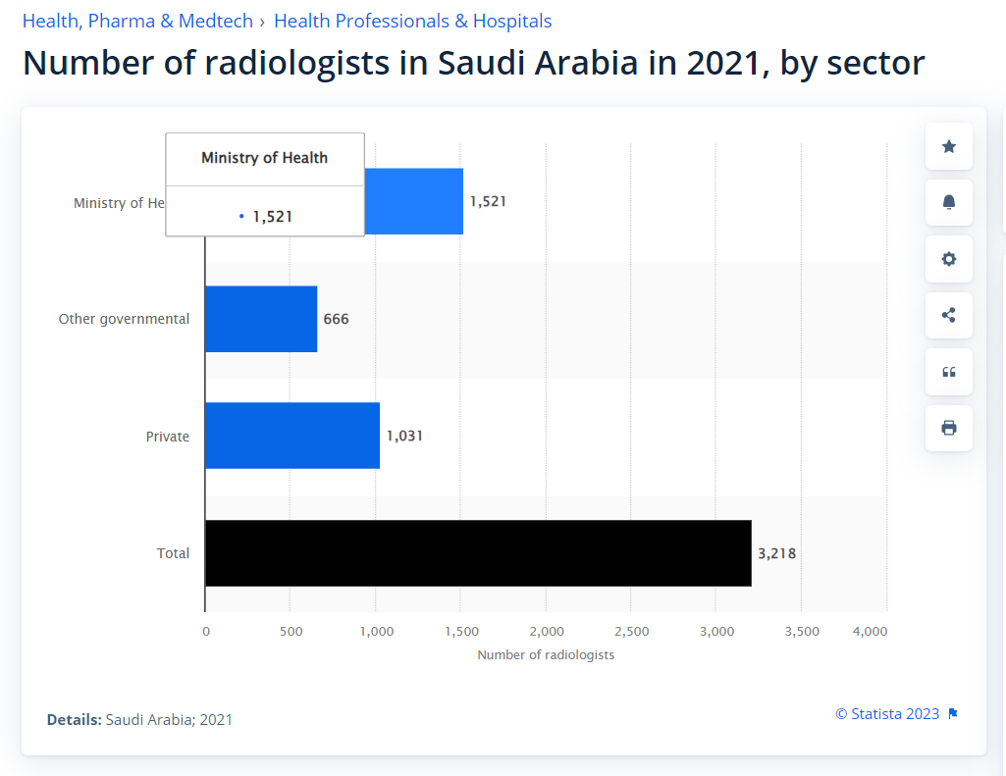
02
Motivation

Slide 6
Motivation
Shorten the time it takes for radiologists to diagnose patients
generate reports on a large number of chest X-rays.
Many X-rays are waiting in queue, and the more serious cases need to be examined first.
X-ray may have noise so the clearer x-ray the more accurate result.

Slide 7
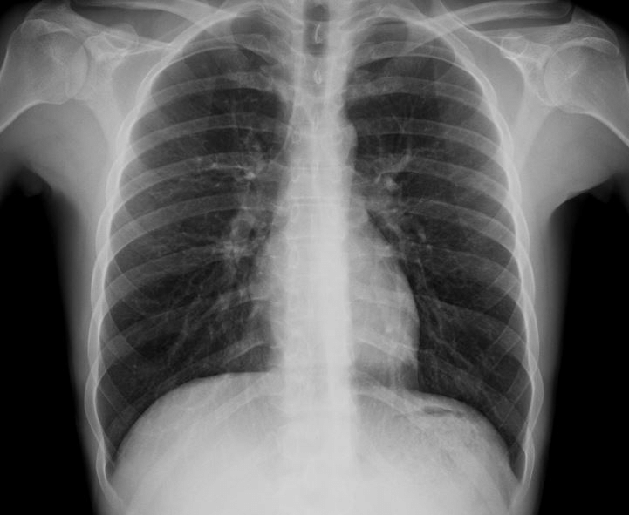
03
Market

Slide 8
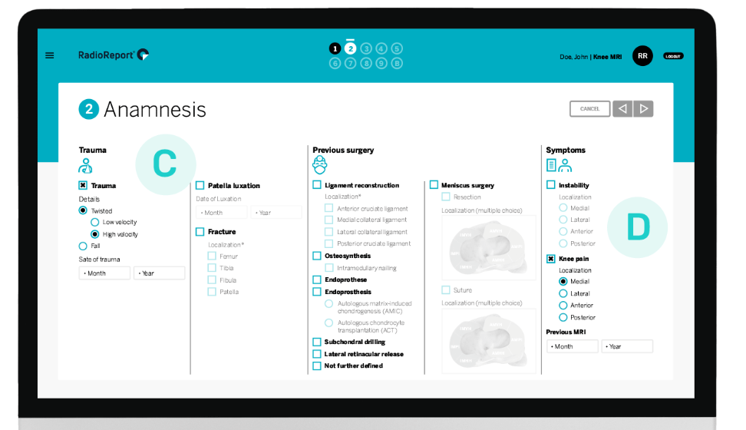
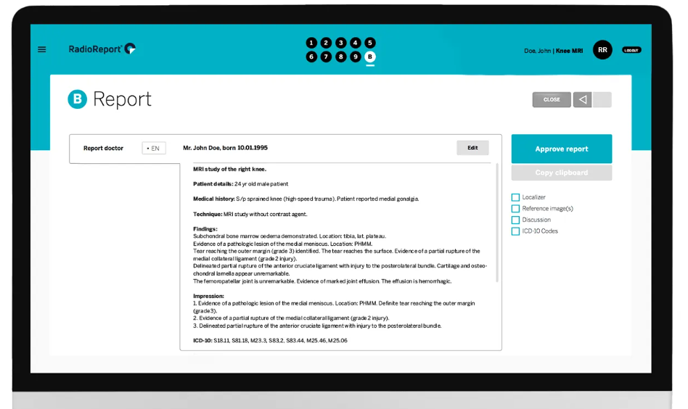
Market Solution
Radio Report → Automation Tool
The software guides you like a virtual
interview to the final report
Notes:
https://radioreport.com/
https://www.ischool.berkeley.edu/projects/2023/vital-smart-sentence-completion-tool-chest-x-ray-reporting

Slide 9
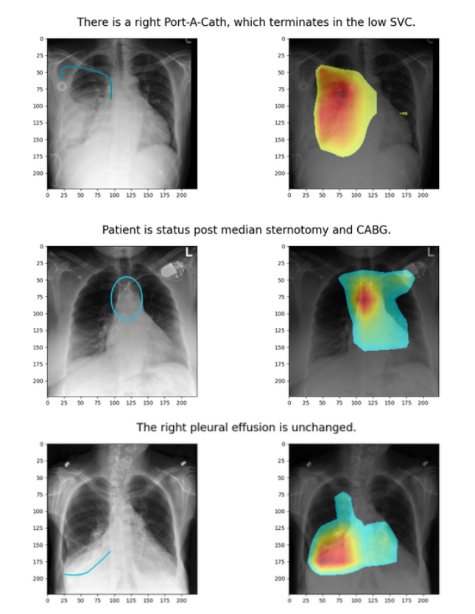
Market Solution
ViTAL → Tool ………………………. readdddddddddd
Notes:
https://radioreport.com/
https://www.ischool.berkeley.edu/projects/2023/vital-smart-sentence-completion-tool-chest-x-ray-reporting

Slide 10
04
Our Tool

Slide 11
Our Solution
The project is an AI solution to automatically diagnose chest x-rays:
denoising the image
detecting anatomical regions and diseases in each region
Generating a full medical report.

Slide 12
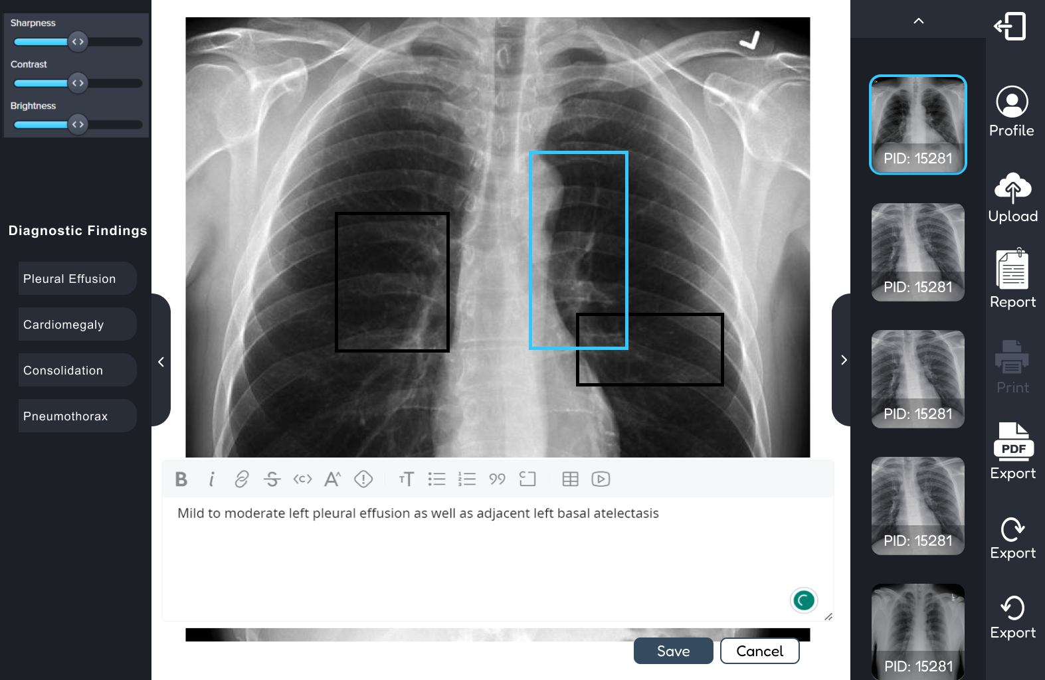
Our Solution

Slide 13
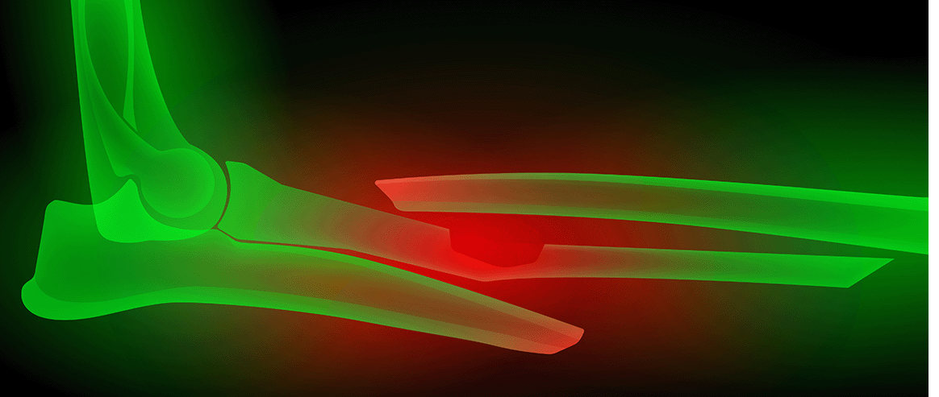
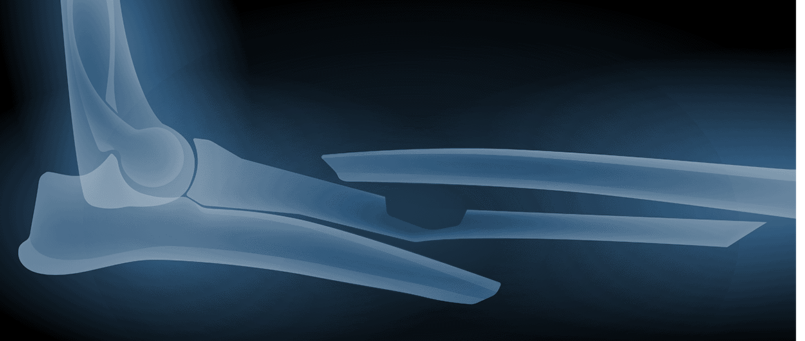
TEMPLATE WITH COLOR FILTER
If you want to apply the same filter as the pictures already included in the template, follow these instructions:
Insert the picture into the slide
Select the photo
Click right mouse button
Go to “Format options” > “Recolor”. Choose the color you need!

Slide 14
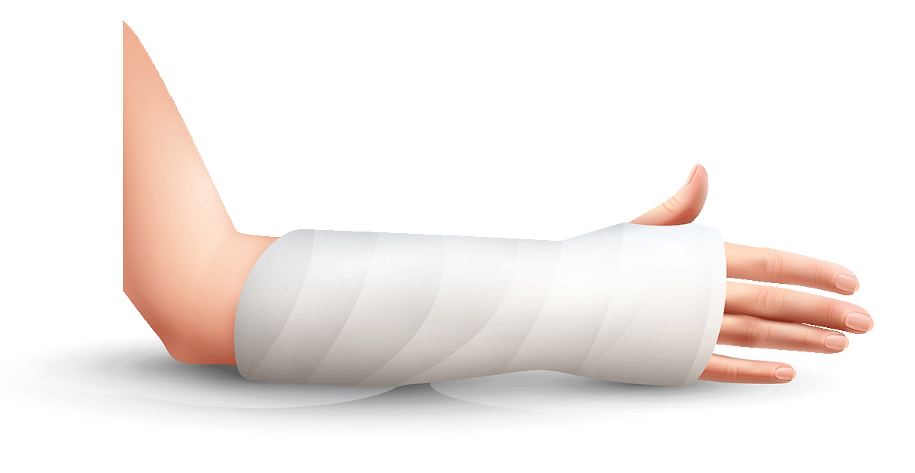
CONTENTS OF THIS TEMPLATE
You can delete this slide when you’re done editing the presentation
FONTS | To view this template correctly in PowerPoint, download and install the fonts we used
USED AND ALTERNATIVE RESOURCES | An assortment of graphic resources that are suitable for use in this presentation
THANKS SLIDE | You must keep it so that proper credits for our design are given
COLORS | All the colors used in this presentation
ICONS AND INFOGRAPHIC RESOURCES | These can be used in the template, and their size and color can be edited
EDITABLE PRESENTATION THEME | You can edit the master slides easily. For more info, click here
For more info: Slidesgo | Blog | FAQs
You can visit our sister projects: Freepik | Flaticon | Storyset | Wepik | Videvo

Slide 15
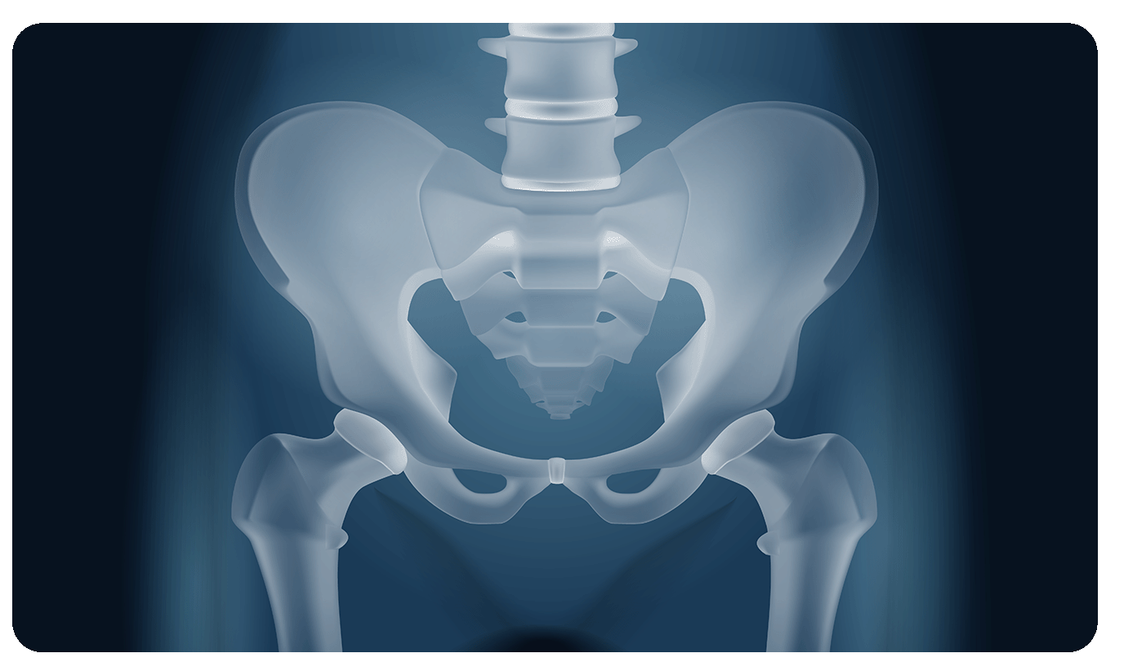
01
INTRODUCTION

Slide 16
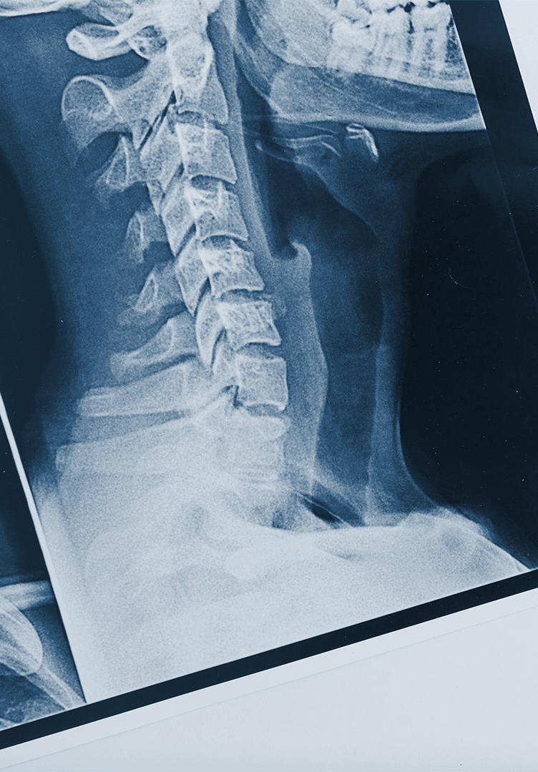
WHAT IS A MEDICAL BREAKTHROUGH?
A medical breakthrough:
Represents a significant advancement in the field of medicine
Challenges conventional medical practices
and beliefs
Holds the potential to revolutionize treatments, improve patient outcomes and save lives
In summary, a medical breakthrough can revolutionize medical care and improve patient lives

Slide 17
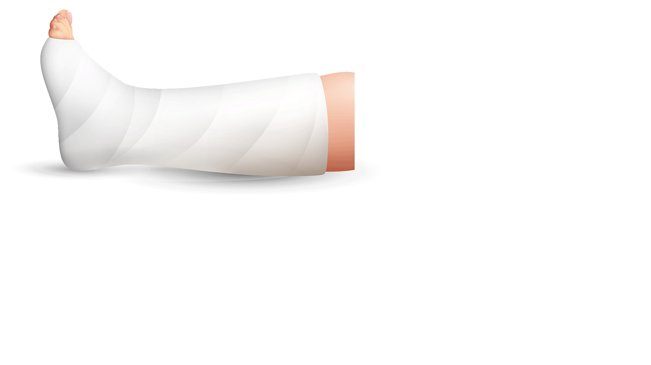
INTRODUCTION
PROBLEM STATEMENT
CONTEXT
Clearly state the specific problem or challenge in the medical field. Emphasize its significance and impact, highlighting gaps or limitations in current knowledge or approaches that motivate the need for a breakthrough
Provide context and emphasize the importance of addressing the identified challenge. Discuss existing knowledge or approaches, emphasizing the gaps that hinder progress and drive the need for innovative solutions

Slide 18
BACKGROUND
Highlight the current challenges and limitations in the medical field that require a breakthrough. Describe the healthcare problems that need innovative solutions
CURRENT LANDSCAPE
Focus on emerging medical trends or scientific discoveries that present an opportunity for a breakthrough. Discuss the potential benefits, such as more accurate diagnostics
EMERGING TRENDS
Outline a visionary goal for the breakthrough, such as curing a disease or revolutionizing procedures. Highlight the broader impact on healthcare and global quality of life
BREAKTHROUGH VISION

Slide 19
METHODOLOGY
STUDY DESIGN
DATA COLLECTION
Outline the research design for the medical breakthrough and describe the type of study, sample size, inclusion criteria and ethical considerations
Explain the methods and tools used for data collection, including patient records or examinations. Emphasize data accuracy and patient privacy
DATA ANALYSIS
RESULTS VALIDATION
Describe the approach for analyzing the collected data. Explain the statistical methods or qualitative analysis techniques used to derive meaningful insights
Discuss the steps taken to validate the results. Explain how the findings will be reviewed, confirmed or peer-reviewed for scientific rigor

Slide 20
RESULTS
DATA ANALYSIS
QUANT. RESULTS
QUAL. RESULTS
Present the analyzed data. Describe the methods used for analysis and highlight key findings and trends
Focus on numerical results derived from the analysis. Present percentages and use visual aids
Discuss qualitative findings from interviews or surveys. Present themes, patterns and include examples
COMPARISON
LIMITATIONS
CONCLUSIONS
Compare results with existing literature or previous studies. Highlight similarities, and novel insights for knowledge
Acknowledge study limitations. Discuss challenges faced during data collection and interpretation
Summarize the findings and their implications. Discuss the impact on medical practice, patient care or future research

Slide 21
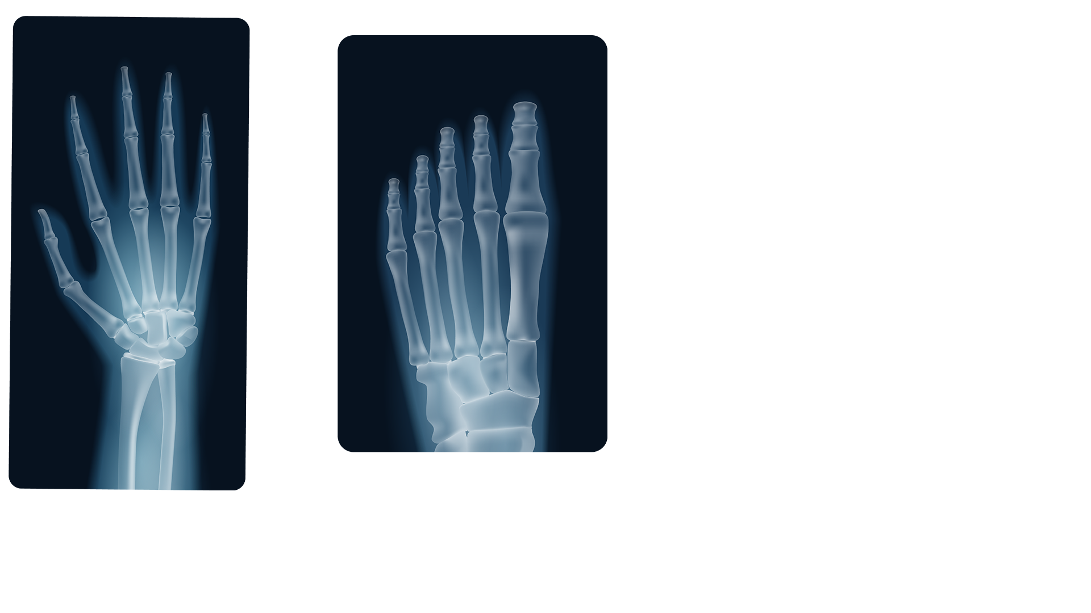
10X FASTER
50%
85%
It’s a treatment 10x faster than others
Reduction in complications
Success rate for the breakthrough

Slide 22
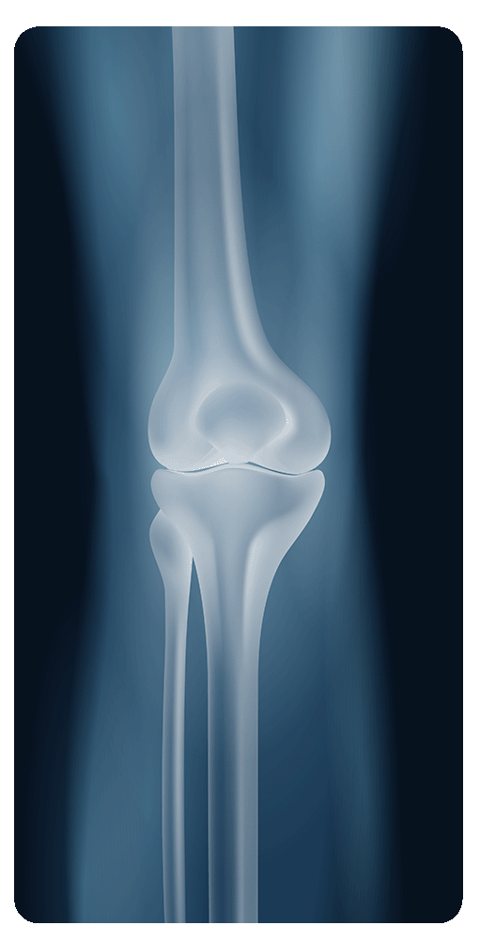
16.75%
Use percentages in your breakthrough presentation to quantify and communicate the frequency or proportion of an important finding

Slide 23
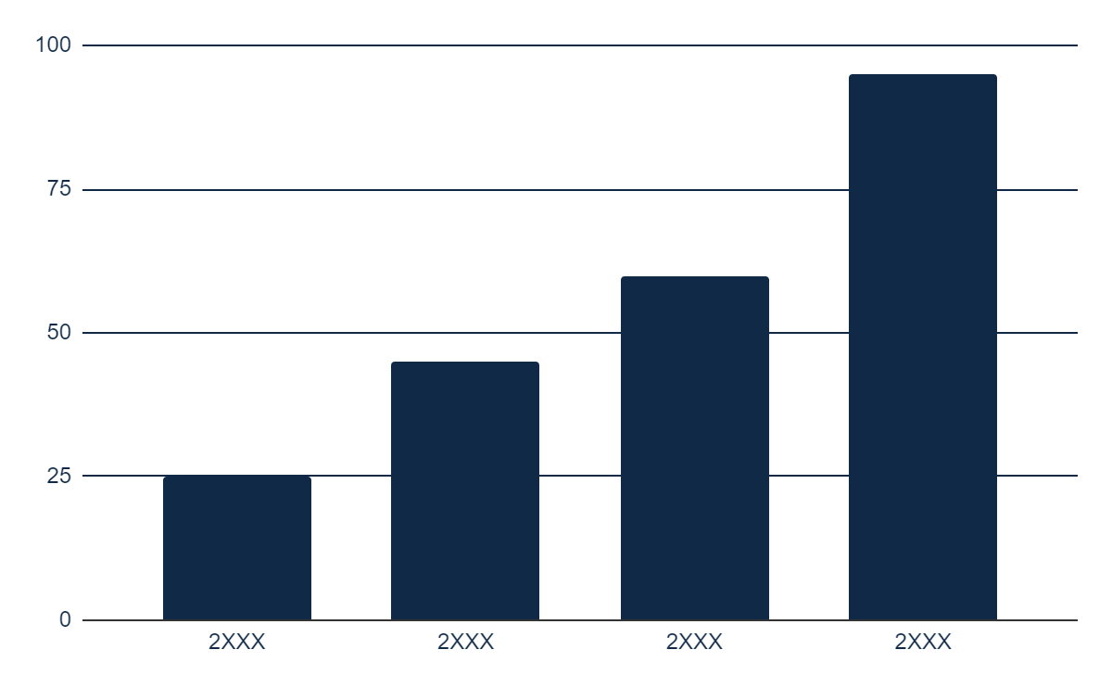
COLUMN CHART
UNDERSTANDING THE NUMBERS
Use this slide to present data on the outcomes of patients who have received treatment for a particular condition or disease. A column chart can be an effective way to illustrate changes in patient outcomes over time. Consider including data from clinical trials or real-world patient populations to showcase the impact
Follow the link in the graph to modify its data and then paste the new one here. For more info, click here

Slide 24
MILESTONES
Discovery
Preclinical research
Early phase
clinical trial
Phase I clinical trial
Phase II clinical trial
Phase III clinical trial
FDA review
Post-market monitoring

Slide 25
TREATMENT OPTIONS
TREATMENT | % RATE | EFFECTS | COST | AVAILABILITY
Medication A | 80% | Mild | $$ | Widely available
Medication B | 70% | Moderate | $$$ | Available only with prescription
Surgery | 90% | High | $$$$ | Requires specialized facilities
Radiation therapy | 75% | Moderate | $$ | Available in most hospitals
Immunotherapy | 65% | Moderate | $$$$ | Available only in select medical centers
Physical therapy | 60% | Mild | $$ | Widely available

Slide 26
CLINICAL TRIAL PHASES
Phase 1: Safety and dosage
Phase 2: Side effects
Participants: 20-100 healthy volunteers
Objective: To determine safe dosage and identify side effects
Duration: 6 months
Success rate: 80% of participants completed the trial without experiencing significant side effects
Participants: Up to 100 people with the condition
Objective: Determine effectiveness and further evaluate safety
Duration: 12 months
Success rate: 65% of participants experienced a significant improvement in symptoms
Phase 3: Large-scale testing
Phase 4: Post-market monitoring
Participants: From several hundred to thousands of people with the condition
Objective: To confirm effectiveness, monitor side effects, and compare to standard treatments
Duration: 24 months
Success rate: a new treatment was better in almost 75% cases
Participants: Thousands of people with the condition who are taking the drug
Objective: To monitor long-term safety and effectiveness and detect rare side effects
Duration: Ongoing
Success rate: No safety concerns identified in the two years since the approval for market use

Slide 27
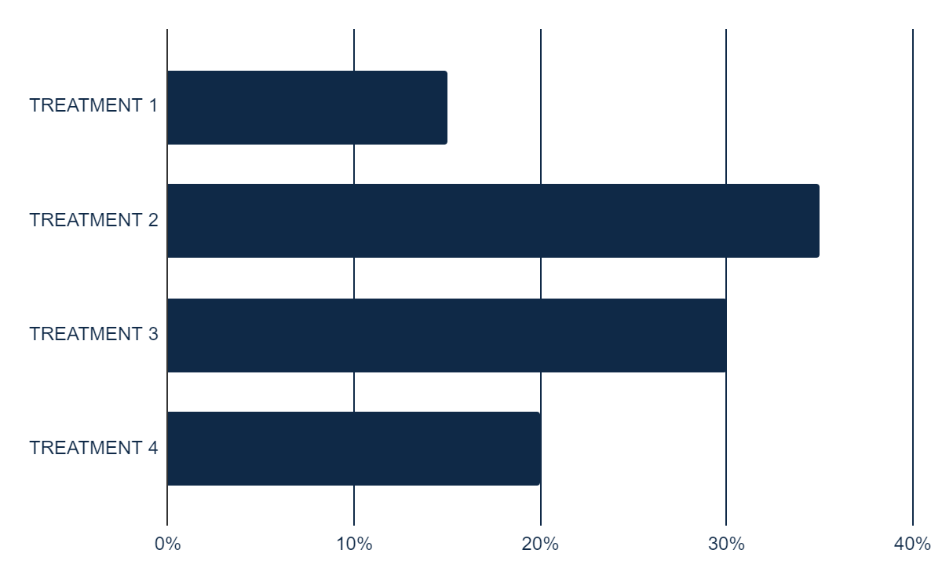
DATA AND STATISTICS
List the key performance indicators (KPIs) relevant to the medical breakthrough
Enter the values or metrics for each KPI in the table
Discuss the significance of each KPI and its relation to the breakthrough
KPIS | NUMBER
Patients treated | 2,500
Success rate | 95%
TREND IN PATIENT OUTCOMES
Illustrate the trend in patient outcomes over time
Highlight the impact of the medical breakthrough on patient outcomes
Describe any significant changes or improvements observed in the graph
Follow the link in the graph to modify its data and then paste the new one here. For more info, click here

Slide 28



IMPLICATIONS
“It's been a true lifesaver for me. I can enjoy life again without any discomfort”
“This breakthrough makes treatment efficient and more personalized”
“We are impressed with the safety and effectiveness of this breakthrough”
—AMY SMITH
—DR. JANE DOE
—DR. JOHN ADDAMS

Slide 29


KEY MEMBERS
MARK JONES
SARAH JAMES
Use a sentence that describes their job
Use a sentence that describes their job
ROLE: Lead Researcher
ROLE: Clinical Trial Manager
CONTRIBUTIONS:
You can enter a description of the contributions here
You can enter a description of the contributions here
CONTRIBUTIONS:
You can enter a description of the contributions here
You can enter a description of the contributions here

Slide 30
RESULTS AND CONCLUSIONS
BACKGROUND
Briefly introduce the context of the investigation, such as the medical condition or problem being addressed and the goals
STUDY DESIGN
Describe the design of the study, such as whether it was a randomized controlled trial or observational study, the sample size and the inclusion and exclusion criteria
FINDINGS
Summarize the main findings of the investigation, including statistical results and any important trends or patterns observed
IMPACT
Discuss the implications of the findings for patients, healthcare providers and other stakeholders. You could also mention any potential limitations of the study or areas for future research
CONCLUSIONS
1
Briefly summarize the main findings of the study or analysis
2
Discuss the implications of the findings and how they relate to the research question
REFERENCES
Include a reference page with the sources used in your presentation. List the sources in alphabetical order and include the author's name, the title of the source, the publication date and the publisher or URL

Slide 31
THANKS
DO YOU HAVE ANY QUESTIONS?
youremail@freepik.com
+91 620 421 838
yourwebsite.com
Please keep this slide for attribution

Slide 32

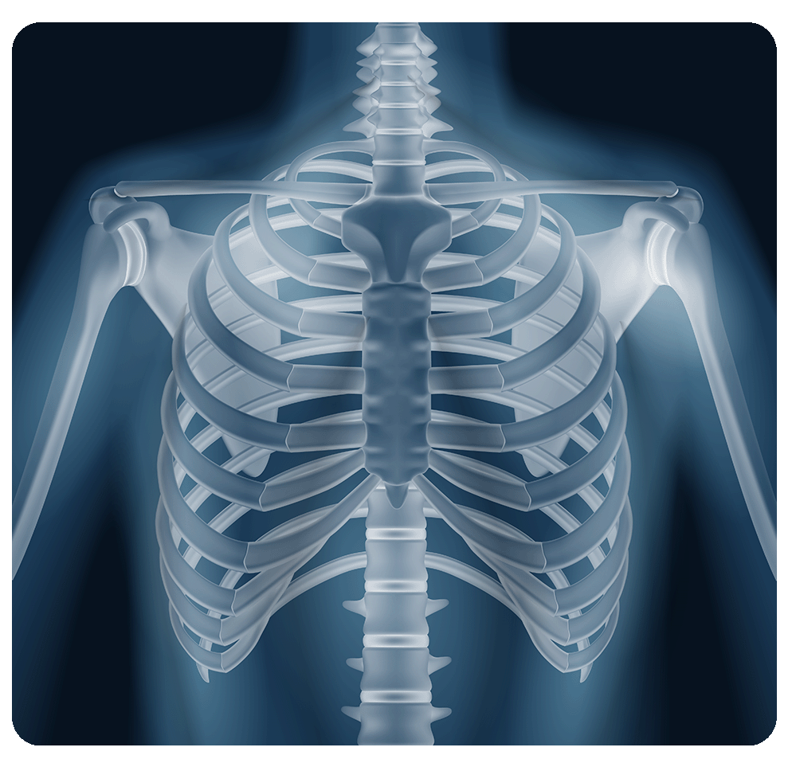

ALTERNATIVE RESOURCES
Here’s an assortment of alternative resources whose style fits the one of this template:
VECTORS
Surgical traumatology concept
Human bones realistic x-ray shots

Slide 33
RESOURCES
Did you like the resources on this template? Get them for free at our other websites:
VECTORS
Surgical traumatology concept
Human bones realistic x-ray shots
PHOTOS
Medic standing with x-ray shot
X ray scan
Medium shot woman at desk
Medium shot doctor with stethoscope
Doctor working in their clinic
Male nurse working at the clinic
Black nurse at their workspace

Slide 34
Instructions for use
If you have a free account, in order to use this template, you must credit Slidesgo by keeping the Thanks slide. Please refer to the next slide to read the instructions for premium users.
As a Free user, you are allowed to:
Modify this template.
Use it for both personal and commercial projects.
You are not allowed to:
Sublicense, sell or rent any of Slidesgo Content (or a modified version of Slidesgo Content).
Distribute Slidesgo Content unless it has been expressly authorized by Slidesgo.
Include Slidesgo Content in an online or offline database or file.
Offer Slidesgo templates (or modified versions of Slidesgo templates) for download.
Acquire the copyright of Slidesgo Content.
For more information about editing slides, please read our FAQs or visit our blog:
https://slidesgo.com/faqs and https://slidesgo.com/slidesgo-school

Slide 35
Instructions for use (premium users)
As a Premium user, you can use this template without attributing Slidesgo or keeping the "Thanks" slide.
You are allowed to:
Modify this template.
Use it for both personal and commercial purposes.
Hide or delete the “Thanks” slide and the mention to Slidesgo in the credits.
Share this template in an editable format with people who are not part of your team.
You are not allowed to:
Sublicense, sell or rent this Slidesgo Template (or a modified version of this Slidesgo Template).
Distribute this Slidesgo Template (or a modified version of this Slidesgo Template) or include it in a database or in any other product or service that offers downloadable images, icons or presentations that may be subject to distribution or resale.
Use any of the elements that are part of this Slidesgo Template in an isolated and separated way from this Template.
Register any of the elements that are part of this template as a trademark or logo, or register it as a work in an intellectual property registry or similar.
For more information about editing slides, please read our FAQs or visit our blog:
https://slidesgo.com/faqs and https://slidesgo.com/slidesgo-school

Slide 36
Fonts & colors used
This presentation has been made using the following fonts:
Catamaran
(https://fonts.google.com/specimen/Catamaran)
Archivo
(https://fonts.google.com/specimen/Archivo)
#0f2947
#ffffff
#c8e6f3
#cdd8e0
#a3b1bd
#2a4964
#081480

Slide 37





Storyset
Create your Story with our illustrated concepts. Choose the style you like the most, edit its colors, pick the background and layers you want to show and bring them to life with the animator panel! It will boost your presentation. Check out how it works.
Pana
Amico
Bro
Rafiki
Cuate

Slide 38
Use our editable graphic resources...
You can easily resize these resources without losing quality. To change the color, just ungroup the resource and click on the object you want to change. Then, click on the paint bucket and select the color you want. Group the resource again when you’re done. You can also look for more infographics on Slidesgo.

Slide 41
JANUARY
FEBRUARY
MARCH
APRIL
MAY
JUNE
PHASE 1
Task 1
Task 2
PHASE 2
Task 1
Task 2
JANUARY
FEBRUARY
MARCH
APRIL
PHASE 1
Task 1
Task 2

Slide 44
...and our sets of editable icons
You can resize these icons without losing quality.
You can change the stroke and fill color; just select the icon and click on the paint bucket/pen.
In Google Slides, you can also use Flaticon’s extension, allowing you to customize and add even more icons.

Slide 45
Educational Icons
Medical Icons

Slide 46
Business Icons
Teamwork Icons

Slide 47
Help & Support Icons
Avatar Icons

Slide 48
Creative Process Icons
Performing Arts Icons

Slide 49
Nature Icons

Slide 50
SEO & Marketing Icons

Slide 51


